Slide 1
Predicting jump risk in high yield spreads
December 2017
Sonja Tilly

Slide 2
Approach and method
Project
Dataset
Feature engineering
Data exploration
Classification
Building basic logistic regression model
Optimising model parameters
Results
Conclusion

Slide 3
Project
Predict jump risk in high yield spreads
Using Bloomberg Barclays US Corporate High Yield Average OAS (LF98OAS Index)
“Jump” is defined as increase in OAS of more than 50bps in 30 days
This is a classification task

Slide 4
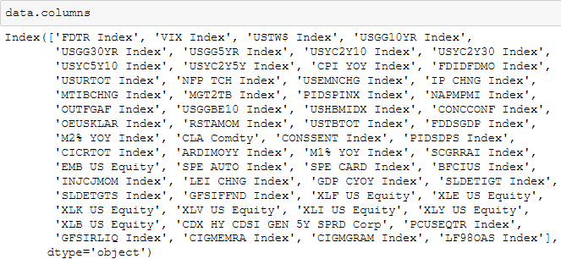
Dataset
The data contains rows of economic indices in daily observations since 1997, showing 7,574 rows and 59 columns.
The target column is the Bloomberg Barclays US Corporate HY Avg OAS Index (LF98OAS Index).

Slide 5
Feature engineering
Address time lags in indicators
Time windows of 30, 90 and 180 days have been defined
The z-score has been calculated for all features for the above defined time windows
Level change and percentage change have been calculated for all features for the above defined time windows

Slide 6
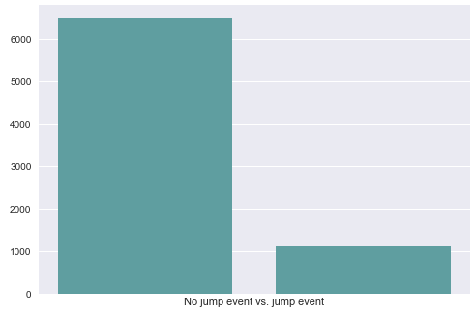
Feature engineering
Transform target variable into binary classification:
LF98OAS Index change in 30ds larger or equal to 0.5 = 1
Else = 0
The target variable is unbalanced, with “jumps” representing less than one sixth of the data.

Slide 7
Feature engineering
Drop the following indices as they are, or relate to the target variable and represent an information leak:
'LF98OAS Index', 'LF98OAS Index change in 30ds','LF98OAS Index change in 90ds', 'LF98OAS Index change in 180ds', 'LF98OAS Index30zscore','LF98OAS Index90zscore', 'LF98OAS Index180zscore'
Address infinite and nan values (replace with zero)

Slide 8
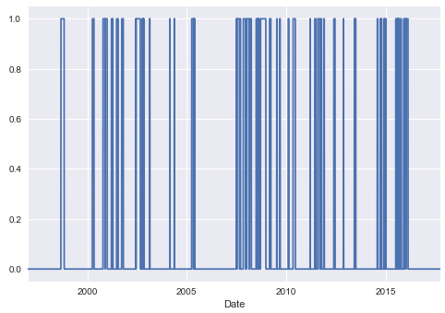
Data exploration
The frequency of jumps in high yield spreads has markedly increased from the global financial crisis in 2008.

Slide 9
Classification
Define predictor variables and target
Split out training and testing sets
Training: first 6,015 observations
Testing: last 1,559 observations
Build Gradient Boosted Tree model
Model evaluation metric: precision and recall metrics
Precision = True positives/(True positives/False positives)
Recall = True positives/(True positives/False negatives)
Notes:
“The precision-recall curve shows the tradeoff between precision and recall for different threshold. A high area under the curve represents both high recall and high precision, where high precision relates to a low false positive rate, and high recall relates to a low false negative rate. High scores for both show that the classifier is returning accurate results (high precision), as well as returning a majority of all positive results (high recall).” source: sklearn

Slide 10
Classification
Tuning the following parameters had positive impact:
Account for unbalanced classes (sample_weight);
Increase number of boosting stages to perform (n_estimators);
Increase the number of nodes in each individual tree (max_depth);
Reduce the number of features considered when looking for the best split (max_features).
Evaluate model performance with cross-validation

Slide 11
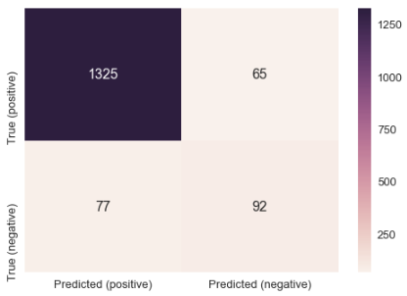
Results: model performance
Precision: 0.9532
Recall: 0.9451
High precision relates to a low false positive rate
High recall relates to a low false negative rate
High scores for both show that the classifier is returning accurate results (high precision), as well as returning a majority of all positive results (high recall).
Notes:
High precision relates to a low false positive rate
High recall relates to a low false negative rate
High scores for both show that the classifier is returning accurate results (high precision), as well as returning a majority of all positive results (high recall).

Slide 12
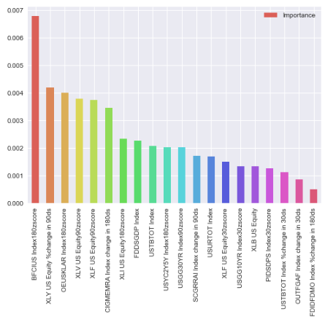
Results: feature importances
Top six features:
BB US Financial Conditions Index;
Consumer Discretionary;
US OECD Lead Indicators;
Healthcare;
Financials;
Citi EM Risk Aversion index.
Notes:
High precision relates to a low false positive rate
High recall relates to a low false negative rate
High scores for both show that the classifier is returning accurate results (high precision), as well as returning a majority of all positive results (high recall).

Slide 13
Conclusion
The model delivers high scores for both precision and recall.
This demonstrates that the classifier is returning accurate results (high precision), as well as returning a majority of all positive results (high recall).
The most important drivers of US high yield spreads are
Financial conditions;
Leading economic indicators;
Specific sectors (which may include a lot of high yield issuers);
Risk aversion.

